Slide 1
Unit 1 Analysis of Algorithms
Kinjal Mistree
Department of Computer Engineering, CGPIT, UTU

Slide 2
Topics to be covered
Algorithm
Efficiency of algorithms
Performance analysis of algorithm
Elementary operation
Asymptotic Notation
Analyzing control statements
Average and worst case analysis
Solving recurrences

Slide 3
PERFORMANCE ANALYSIS of algorithm

Slide 4

Linear Search
Suppose, you are given a jar containing some business cards.
You are asked to determine whether the name “Mukesh Ambani" is in the jar.
To do this, you decide to simply go through all the cards one by one.
How long this takes?
Can be determined by how many cards are in the jar, i.e., Size of Input.

Slide 5
Linear Search
Linear search is a method for finding a particular value from the given list.
The algorithm checks each element, one at a time and in sequence, until the desired element is found.
Linear search is the simplest search algorithm.
It is a special case of brute-force search.

Slide 6









Linear Search - Example
Search for $1$ in given array
$$2$$ | $$9$$ | $$3$$ | $$1$$ | $$8$$
Comparing value of i^{th} index with the given element one by one, until we get the required element or end of the array
Step 1: i=0
Step 3: i=2
$$2$$ | $$9$$ | $$3$$ | $$1$$ | $$8$$
$$2$$ | $$9$$ | $$3$$ | $$1$$ | $$8$$
i
i
$$2≠1$$
$$3≠1$$
Step 2: i=1
Step 4: i=3
$$1$$
$$2$$ | $$9$$ | $$3$$ | $$1$$ | $$8$$
$$2$$ | $$9$$ | $$3$$ | $$1$$ | $$8$$
i
i
$$9≠1$$
Element found at i^{th} index, i=3

Slide 7
Linear Search Algorithm
# Input : Array A, element
# Output : First index of element in A or
-1 if not found
Algorithm: Linear_Search
for i = 1 to last index of A:
if A[i] equals element:
return i
return -1

Slide 8
Linear Search
The required element in the given array can be found at,
E.g. 2: It is at the first position
Best Case: minimum comparison is required
E.g. 3 or 1: Anywhere after the first position
Average Case: average number of comparison is required
E.g. 8 or 7: Last position or does not found at all
Worst Case: maximum comparison is required
Worst Case
2
2 | 9 | 3 | 1 | 8
Best Case
Average Case

Slide 9
Analysis of Algorithm
Best case | Average case | Worst case
Resource usage is minimum | Resource usage is average | Resource usage is maximum
Algorithm’s behavior under optimal condition | Algorithm’s behavior under random condition | Algorithm’s behavior under the worst condition
Minimum number of steps or operations | Average number of steps or operations | Maximum number of steps or operations
Lower bound on running time | Average bound on running time | Upper bound on running time
Generally occurs very rare in real | Average and worst-case performances are the most used in algorithm analysis.

Slide 10
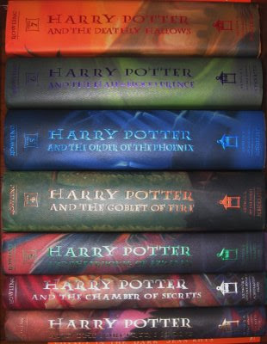
Book Finder
Suppose, you are writing a program to find a book from the shelf.
For any required book, it will start checking books one by one from the bottom.
If you wanted Harry Potter 3, it would only take 3 actions (or tries) because it’s the third book in the sequence.
If Harry Potter 7 — it’s the last book so it would have to check all 7 books.
What if there are total 10 books? How about 10,00,000 books? It would take 1 million tries.

Slide 11
Number Sorting
Suppose you are sorting numbers in Ascending / Increasing order.
The initial arrangement of given numbers can be in any of the following three orders.
Numbers are already in required order, i.e., Ascending order
No change is required – Best Case
Numbers are randomly arranged initially.
Some numbers will change their position – Average Case
Numbers are initially arranged in Descending or Decreasing order.
All numbers will change their position – Worst Case
5 | 9 | 12 | 23 | 32 | 41
9 | 5 | 12 | 32 | 23 | 41
5 | 9 | 12 | 23 | 32 | 41
41 | 32 | 23 | 12 | 9 | 5

Slide 12
Best, Average, & Worst Case
Problem
Linear Search
Book Finder
Sorting
Best Case
Average Case
Worst Case
Element at the first position | Element in any of the middle positions | Element at last position or not present
The first book | Any book in-between | The last book
Already sorted | Randomly arranged | Sorted in reverse order

Slide 13
Bounds on Running Time
Lower Bound:
A lower bound L(n) of an algorithm defines the minimum time required, it is not possible to have any other algorithm (for the same problem) whose time complexity is less than L(n) for random input.
Upper Bound:
An upper bound U(n) of an algorithm defines the maximum time required, we can always solve the problem in at most U(n) time. Time taken by a known algorithm to solve a problem with worse case input gives the upper bound.

Slide 14
Elementary Operation

Slide 15
Elementary operation
An elementary operation is one whose execution time can be bounded above by a constant depending only on the implementation used by the machine, the programming language, ... and so on.
Constant doesn't depend on the other parameters of the instance being considered.
Since we're concerned with the execution times defined to within a multiplicative constant, it is only the number of elementary operations that matters in the analysis, not the exact time required by each of them.

Slide 16
Elementary operation
Example:
An instance in an algorithm requires a: addition, m: multiplication, s: assignment instructions
Suppose t_{a} , t_{m} , t_{s} microseconds is the time requirement for each operation.
Total time required can be bounded by: t ≤ at_{a} + mt_{m} + st_{s}
≤ max ( t_{a} , t_{m} , t_{s} ) ∗ ( a + m + s )
Since exact time required by each elementary operation is unimportant, we simplify by saying that elementary operations can be executed at unit cost.
Number of elementary operations

Slide 17
Elementary operation
Example:
A single line of a program may correspond to a number of elementary operations.
x ← min { T [ i ] | 1 ≤ i ≤ n} and this is an abbreviation of
x ← T [ 1 ]
for i ← 2 to n do
if T [ i ] < x then x ← T [ i ]
We shall consider additions, subtractions, multiplications, divisions, modulo operations, Boolean operations, comparisons and assignments to be elementary operations that can be executed at unit cost.

Slide 18
Asymptotic Notation

Slide 19
Asymptotic Notations
Asymptotic Notations (Big O, θ - Theta and Ω - Omega) allow us to analyze an algorithm’s running time.
This is also known as an algorithm’s growth rate.
Asymptotic Notations are used
To characterize the complexity of an algorithm.
To compare the performance of two or more algorithms solving the same problem.

Slide 20
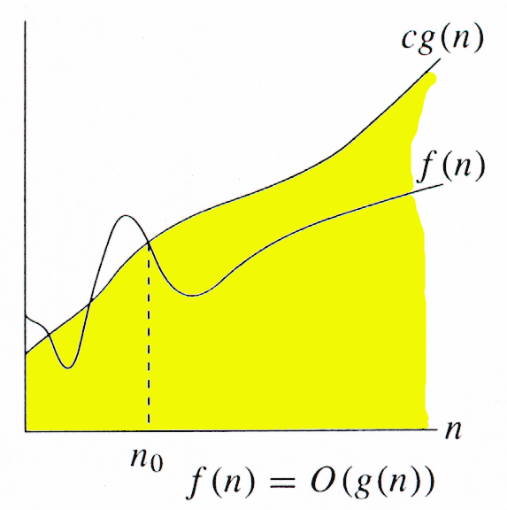
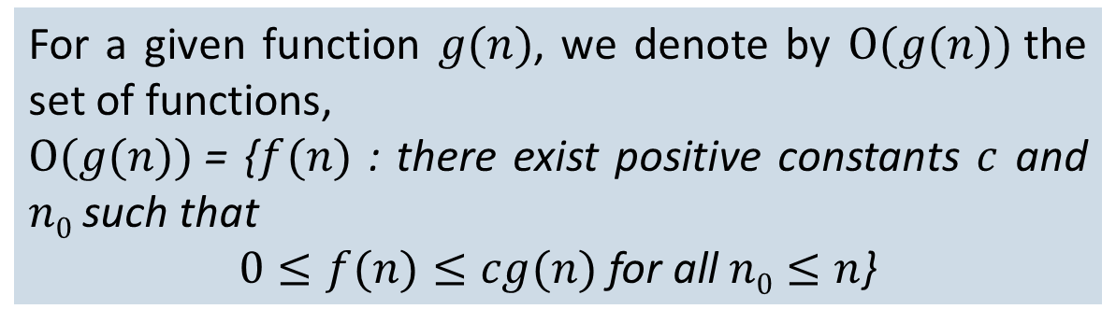
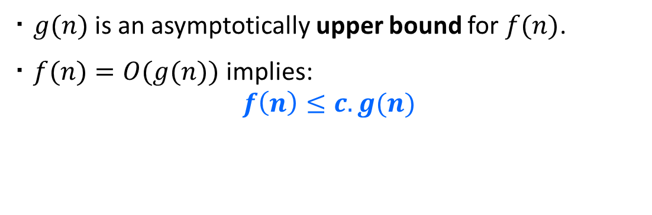
O-Notation (Big O notation) (Upper Bound)
For a given function $g(n)$, we denote by $Ο(g(n))$the set of functions,
$Ο(g(n))$= {$f(n)$ : there exist positive constants $c$ and $n0$ such that
$0≤f(n)≤cg(n)$for all $n0≤n$}
$g(n)$ is an asymptotically upper bound for $f(n)$.
$f(n)=O(g(n))$implies:
$$f\left(n\right)≤c.g(n)$$

Slide 21
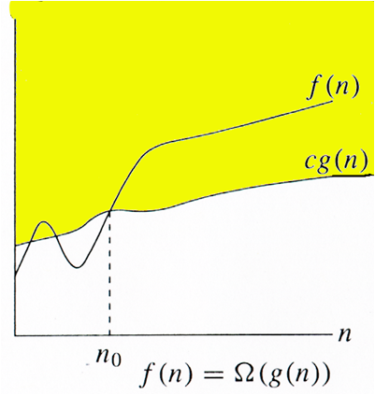
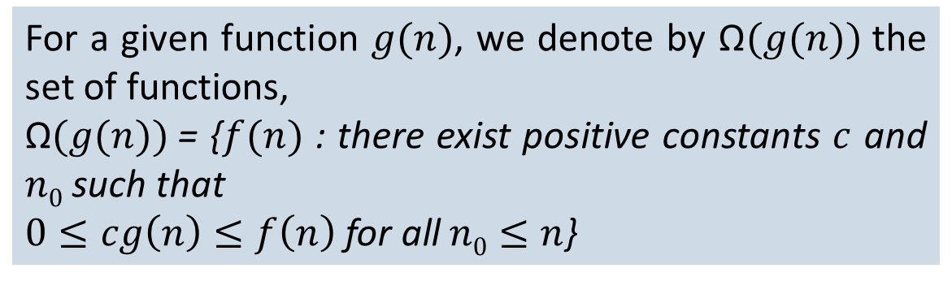
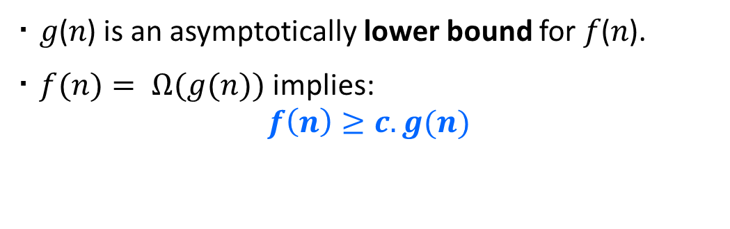
Ω-Notation (Omega notation) (Lower Bound)
For a given function $g(n)$, we denote by Ω$(g(n))$the set of functions,
$\text{Ω}(g(n))$= {$f(n)$ : there exist positive constants $c$ and $n0$ such that
$0≤cg\left(n\right)≤f\left(n\right)$for all$n0≤n$}
𝑔(𝑛) is an asymptotically lower bound for 𝑓(𝑛).
$f(n)= Ω(g(n))$implies:
$$f\left(n\right)≥c.g(n)$$

Slide 22
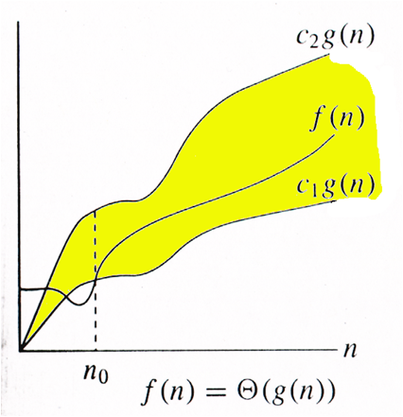
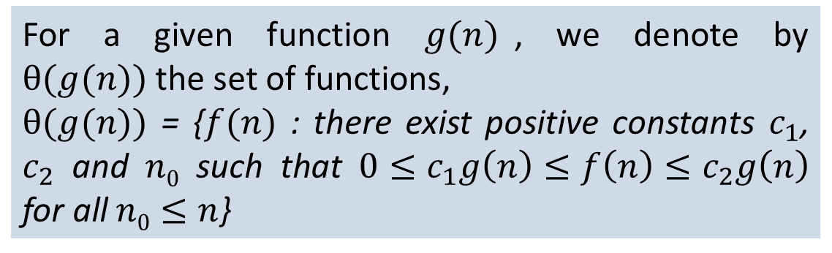
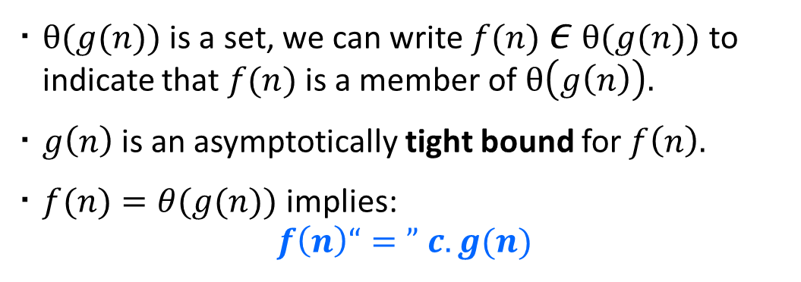
θ-Notation (Theta notation) (Same order)
For a given function $g(n)$, we denote by $θ(g(n))$the set of functions,
$θ(g(n))$ = {$f(n)$ : there exist positive constants $c_{1}$, $c_{2}$ and $n0$ such that $0≤c_{1}g\left(n\right)≤f\left(n\right)≤c_{2}g\left(n\right)$ for all$n0≤n$}
$θ(g(n))$ is a set, we can write $f(n)$ $ε$ $θ(g(n))$ to indicate that $f(n)$ is a member of $θ\left(g\left(n\right)\right).$
$g\left(n\right)$ is an asymptotically tight bound for $f\left(n\right).$
$f(n)=θ(g(n))$implies:
$$f\left(n\right)“=” c.g(n)$$

Slide 23
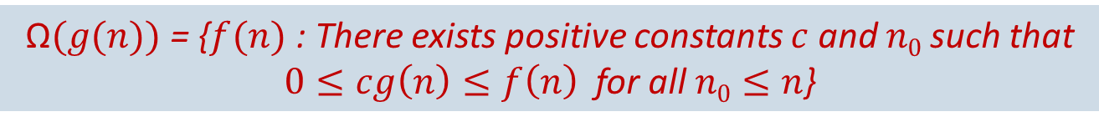
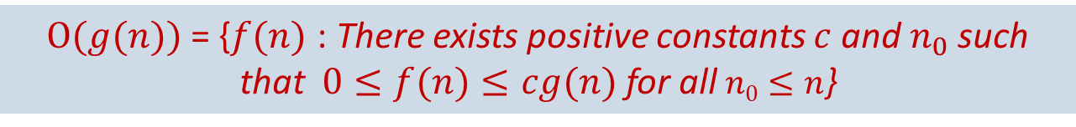
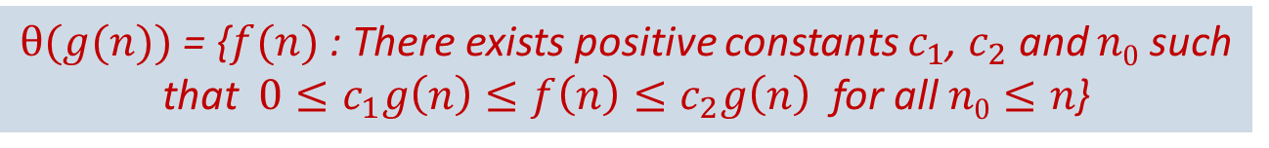
Asymptotic Notations
O-Notation (Big O notation) (Upper Bound)
Ω-Notation (Omega notation) (Lower Bound)
θ-Notation (Theta notation) (Same order)
$Ο(g(n))$= {$f(n)$ : There exists positive constants $c$ and${ n}_{0}$ such that$0≤f(n)≤cg(n)$for all$n0≤n$}
$\text{Ω}(g(n))$= {$f(n)$ : There exists positive constants $c$ and $n0$ such that
$0≤cg\left(n\right)≤f\left(n\right)$ for all$n0≤n$}
$θ(g(n))$ = {$f(n)$ : There exists positive constants $c_{1}$, $c_{2}$ and $n0$ such that $0≤c_{1}g\left(n\right)≤f\left(n\right)≤c_{2}g\left(n\right)$ for all$n0≤n$}

Slide 24


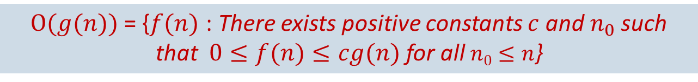
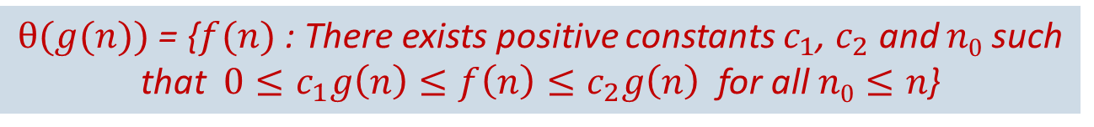

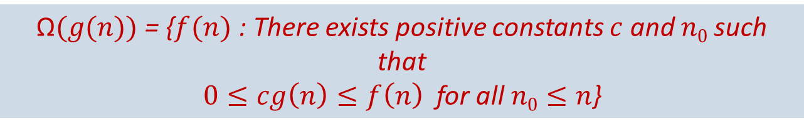
Asymptotic Notations
$$f(n)=O(g(n))$$
$Ο(g(n))$= {$f(n)$ : There exists positive constants $c$ and${ n}_{0}$ such that$0≤f(n)≤cg(n)$for all$n0≤n$}
$$f(n)=\text{Ω}(g(n))$$
$\text{Ω}(g(n))$= {$f(n)$ : There exists positive constants $c$ and $n0$ such that
$0≤cg\left(n\right)≤f\left(n\right)$ for all$n0≤n$}
$$f(n)=θ(g(n))$$
$θ(g(n))$ = {$f(n)$ : There exists positive constants $c_{1}$, $c_{2}$ and $n0$ such that $0≤c_{1}g\left(n\right)≤f\left(n\right)≤c_{2}g\left(n\right)$ for all$n0≤n$}

Slide 25
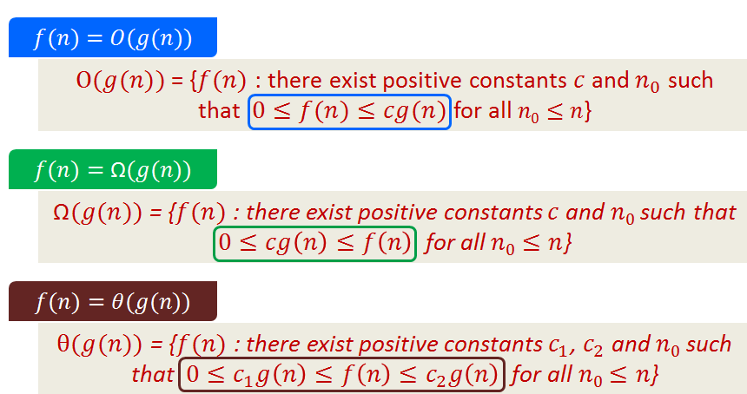
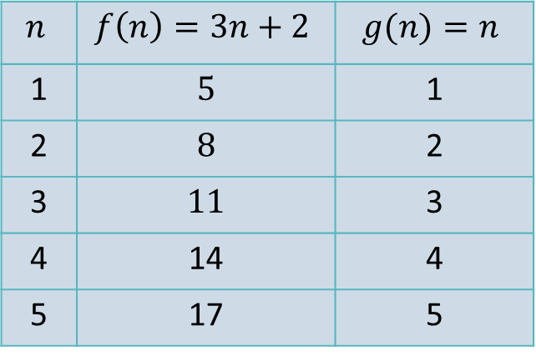

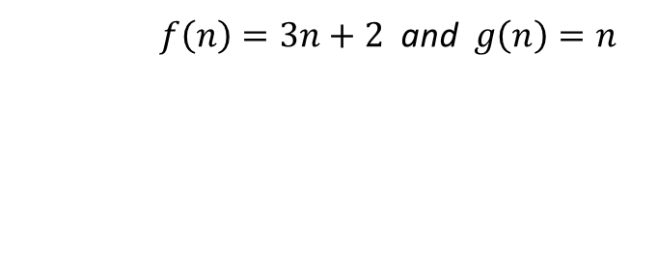


Asymptotic Notations - Example
$f\left(n\right)=3n+2$ and $g\left(n\right)=n$
Example 1
Algo. 1 running time
Algo. 2 running time
$$f\left(n\right)≥c∗g\left(n\right)$$
$$f\left(n\right)=\text{Ω}(g(n))$$
$$n$$ | $$f\left(n\right)=3n+2$$ | $$g(n)=n$$
1 | 5 | 1
2 | 8 | 2
3 | 11 | 3
4 | 14 | 4
5 | 17 | 5
$$c=1,\text{n}\text{0}=1$$

Slide 26

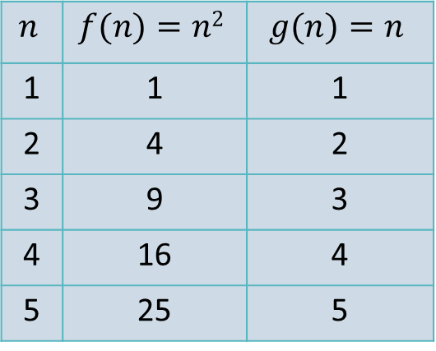


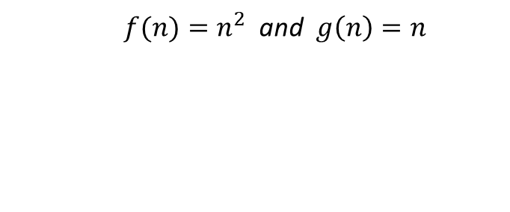



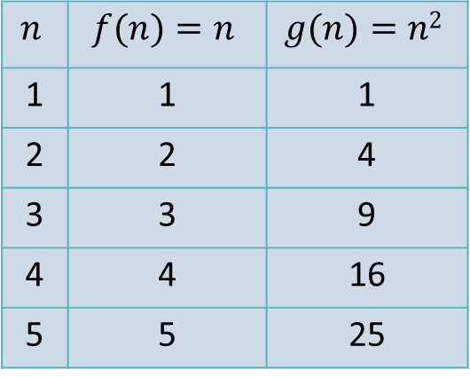
Asymptotic Notations - Example
$f(n)=n^{2}$ and $g\left(n\right)=n$
Example 2
$f(n)=n$ and $g\left(n\right)=n^{2}$
Example 3
Algo. 1 running time
Algo. 2 running time
Algo. 1 running time
Algo. 2 running time
$$f\left(n\right)≥c∗g\left(n\right)$$
$$f\left(n\right)=\text{Ω}(g(n))$$
$$f\left(n\right)≤c∗g\left(n\right)$$
$$f\left(n\right)=\text{O}(g(n))$$
$$n$$ | $$f(n)=n2$$ | $$g(n)=n$$
1 | 1 | 1
2 | 4 | 2
3 | 9 | 3
4 | 16 | 4
5 | 25 | 5
$$n$$ | $$f(n)=n$$ | $$g(n)=n2$$
1 | 1 | 1
2 | 2 | 4
3 | 3 | 9
4 | 4 | 16
5 | 5 | 25
$$c=1,\text{n}\text{0}=1$$
$$c=1,\text{n}\text{0}=1$$

Slide 27
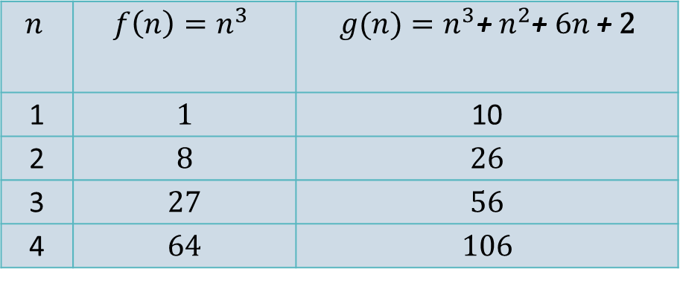

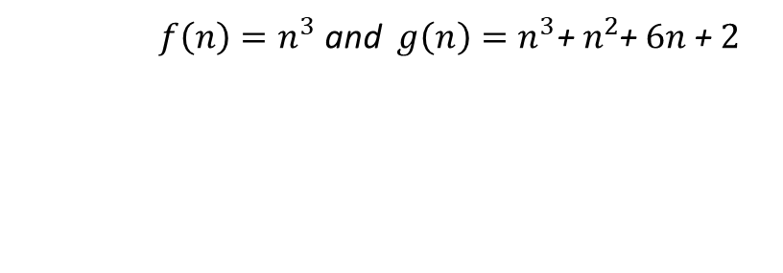


Asymptotic Notations - Example
$f\left(n\right)=n^{3}$ and $g\left(n\right)=n^{3}\text{+} n^{2}$+ $6n \text{+}$ 2
Example 4
Algo. 1 running time
Algo. 2 running time
$$f\left(n\right)≤c∗g\left(n\right)$$
$$f\left(n\right)=\text{O}(g(n))$$
$$n$$ | $$f\left(n\right)=n^{3}$$ | $$g(n)=n^{3}\text{+} n^{2}\text{+ }6n \text{+}\text{ 2}$$
1 | 1 | 10
2 | 8 | 26
3 | 27 | 56
4 | 64 | 106
$$c=1,\text{n}\text{0}=1$$

Slide 28
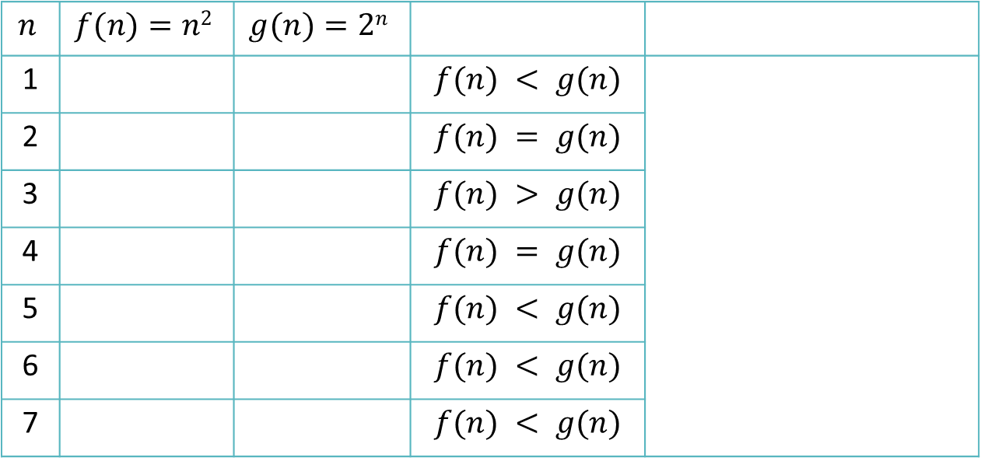



Asymptotic Notations - Example
Example 5: Let $f\left(n\right)=n^{2}$ and $g\left(n\right)= 2^{n}$
$$f\left(n\right)=\text{O}\left(g\left(n\right)\right)$$
Algo. 1 running time
Algo. 2 running time
$$n$$ | $$f(n)=n2$$ | $$g(n)=2n$$
1 |  |  | $$f(n) < g(n)$$
2 |  |  | $$f(n) = g(n)$$
3 |  |  | $$f(n) > g(n)$$
4 |  |  | $$f(n) = g(n)$$
5 |  |  | $$f(n) < g(n)$$
6 |  |  | $$f(n) < g(n)$$
7 |  |  | $$f(n) < g(n)$$
1
2
4
4
9
8
16
16
Here for $n≥4$, $f\left(n\right)≤c∗g\left(n\right)$
$$so, n0=4, c=1$$
25
32
36
64
49
128

Slide 29
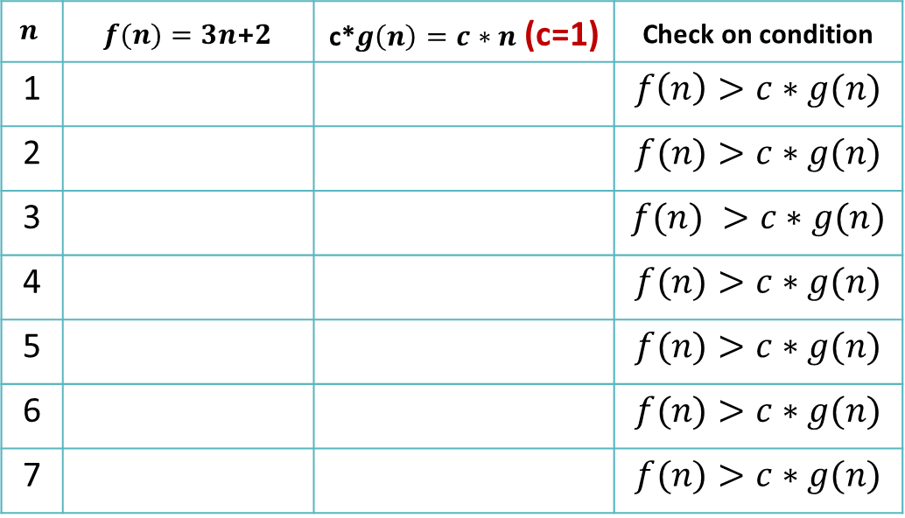


Asymptotic Notations - Example
$$Prove that$$
$$f\left(n\right)=\text{O}\left(g\left(n\right)\right)$$
Example 6: Let $f\left(n\right)=3n+2$ and $g\left(n\right)=n$
Algo. 1 running time
Algo. 2 running time
$$n$$ | $f(n)=3n$+2 | c*$g\left(n\right)=c∗n$ (c=1) | Check on condition
1 |  |  | $$f\left(n\right)>c∗g(n)$$
2 |  |  | $$f(n)>c∗g(n)$$
3 |  |  | $$f(n) >c∗g(n)$$
4 |  |  | $$f(n)>c∗g(n)$$
5 |  |  | $$f(n)>c∗g(n)$$
6 |  |  | $$f(n)>c∗g(n)$$
7 |  |  | $$f(n)>c∗g(n)$$
5
1
8
2
11
3
14
4
17
5
20
6
22
7

Slide 30
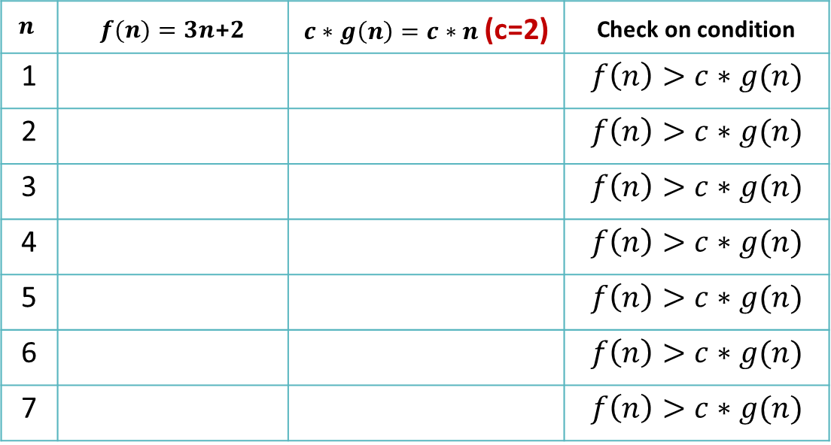

Asymptotic Notations - Example
Example 7: Let $f\left(n\right)=3n+2$ and $g\left(n\right)=n$
Algo. 1 running time
Algo. 2 running time
$$n$$ | $f(n)=3n$+2 | $c∗g\left(n\right)=c∗n$ (c=2) | Check on condition
1 |  |  | $$f\left(n\right)>c∗g(n)$$
2 |  |  | $$f\left(n\right)>c∗g(n)$$
3 |  |  | $$f\left(n\right)>c∗g(n)$$
4 |  |  | $$f\left(n\right)>c∗g(n)$$
5 |  |  | $$f\left(n\right)>c∗g(n)$$
6 |  |  | $$f\left(n\right)>c∗g(n)$$
7 |  |  | $$f\left(n\right)>c∗g(n)$$
5
2
8
4
11
6
14
8
17
10
20
12
22
14

Slide 31


Asymptotic Notations - Example
Example 8: Let $f\left(n\right)=3n+2$ and $g\left(n\right)=n$
Algo. 1 running time
Algo. 2 running time
$$n$$ | $f(n)=3n$+2 | $c∗g\left(n\right)=c∗n$ (c=3) | Check on condition
1 |  |  | $$f\left(n\right)>c∗g(n)$$
2 |  |  | $$f\left(n\right)>c∗g(n)$$
3 |  |  | $$f\left(n\right)>c∗g(n)$$
4 |  |  | $$f\left(n\right)>c∗g(n)$$
5 |  |  | $$f\left(n\right)>c∗g(n)$$
6 |  |  | $$f\left(n\right)>c∗g(n)$$
7 |  |  | $$f\left(n\right)>c∗g(n)$$
5
3
8
6
11
9
14
12
17
15
20
18
22
21

Slide 32
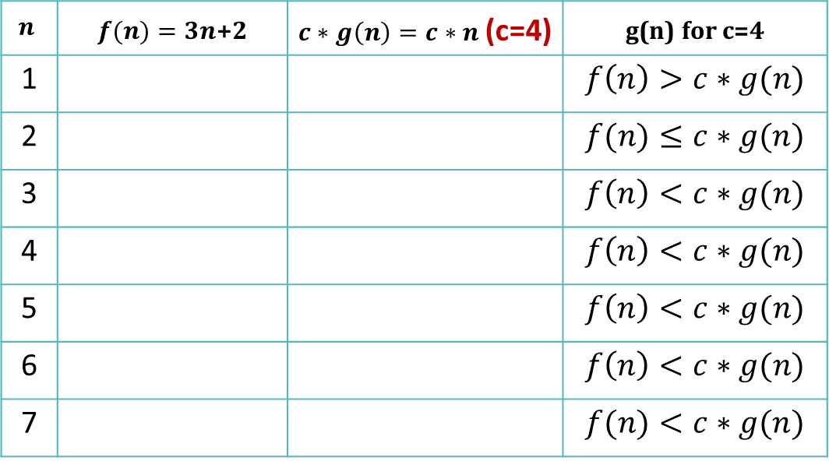


Asymptotic Notations - Example
Example 9: Let $f\left(n\right)=3n+2$ and $g\left(n\right)=n$
$$f\left(n\right)=\text{O}\left(g\left(n\right)\right)$$
Algo. 1 running time
Algo. 2 running time
$$n$$ | $f(n)=3n$+2 | $c∗g\left(n\right)=c∗n$ (c=4) | g(n) for c=4
1 |  |  | $$f\left(n\right)>c∗g(n)$$
2 |  |  | $$f(n)≤c∗g(n)$$
3 |  |  | $$f\left(n\right)<c∗g(n)$$
4 |  |  | $$f\left(n\right)<c∗g(n)$$
5 |  |  | $$f\left(n\right)<c∗g(n)$$
6 |  |  | $$f\left(n\right)<c∗g(n)$$
7 |  |  | $$f(n)<c∗g(n)$$
Here for $n≥2$, $f\left(n\right)≤c∗g\left(n\right)$
$$so, n0=2, c=4$$
5
4
8
8
11
12
14
16
17
20
20
24
22
28

Slide 33



Asymptotic Notations - Example
$$Prove that$$
$$f\left(n\right)=\text{O}\left(g\left(n\right)\right)$$
Example 10: Let $f\left(n\right)={5n}^{3}\text{+} n^{2}\text{+ }6n \text{+}\text{ 2}$and $g\left(n\right)=n^{3}$
$$n$$ | $$f(n)$$ | c*$g\left(n\right)$(c=6) | Check on condition
1 |  |  | $$f\left(n\right)>c∗g(n)$$
2 |  |  | $$f(n)>c∗g(n)$$
3 |  |  | $$f(n) >c∗g(n)$$
4 |  |  | $$f\left(n\right)<c∗g(n)$$
5 |  |  | $$f\left(n\right)<c∗g(n)$$
Here for $n≥4$, $f\left(n\right)≤c∗g\left(n\right)$
$$so, n0=4, c=6$$
14
6
58
48
164
162
362
384
682
750

Slide 34
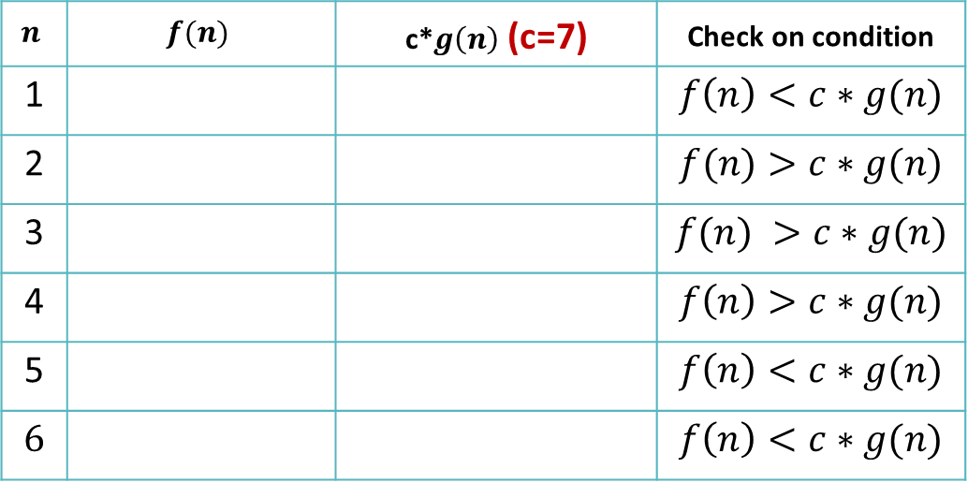


Asymptotic Notations - Example
$$Prove that$$
$$f\left(n\right)=\text{O}\left(g\left(n\right)\right)$$
Example 11: Let $f\left(n\right)=2^{n}\text{+} {6n}^{2}\text{+ }3n$and $g\left(n\right)=2^{n}$
$$n$$ | $$f(n)$$ | c*$g\left(n\right)$(c=7) | Check on condition
1 |  |  | $$f\left(n\right)<c∗g(n)$$
2 |  |  | $$f(n)>c∗g(n)$$
3 |  |  | $$f(n) >c∗g(n)$$
4 |  |  | $$f\left(n\right)>c∗g(n)$$
5 |  |  | $$f\left(n\right)<c∗g(n)$$
6 |  |  | $$f\left(n\right)<c∗g(n)$$
Here for $n≥5$, $f\left(n\right)≤c∗g\left(n\right)$
$$so, n0=5, c=7$$
11
14
34
28
71
56
124
112
197
224
298
448

Slide 35
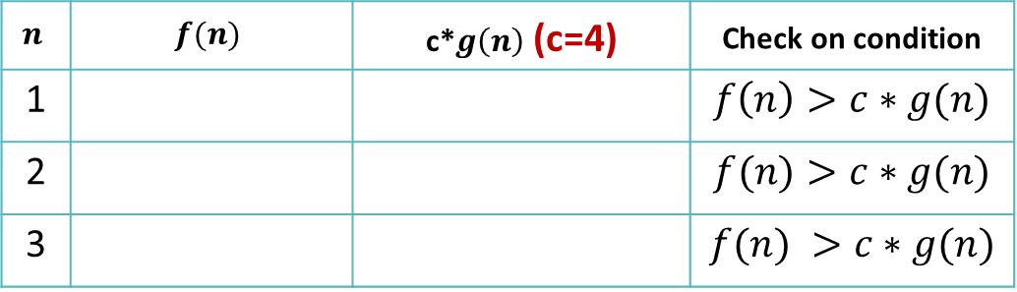



Asymptotic Notations - Example
$$Prove that$$
$$f\left(n\right)=\text{Ω} \left(g\left(n\right)\right)$$
Example 12: Let $f\left(n\right)={4∗2}^{n}\text{+} 3n$and $g\left(n\right)=2^{n}$
$$n$$ | $$f(n)$$ | c*$g\left(n\right)$(c=4) | Check on condition
1 |  |  | $$f\left(n\right)>c∗g(n)$$
2 |  |  | $$f(n)>c∗g(n)$$
3 |  |  | $$f(n) >c∗g(n)$$
Here for $n≥1$, $f\left(n\right)≥c∗g\left(n\right)$
$$so, n0=1, c=4$$
11
8
22
16
41
32

Slide 36
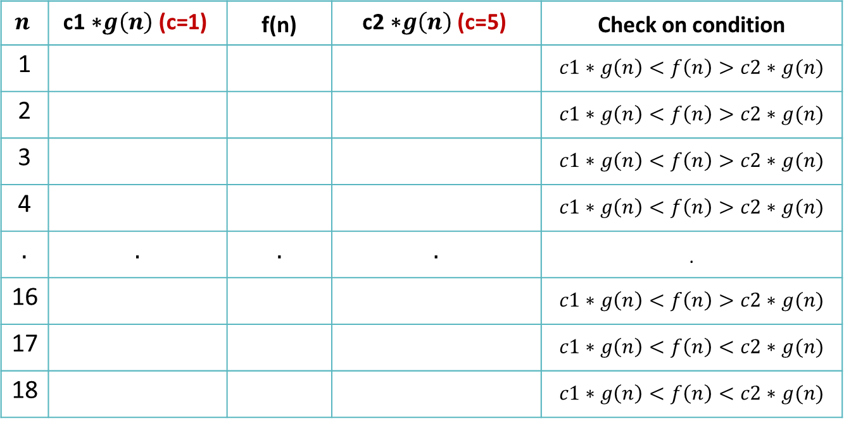



Asymptotic Notations - Example
$$Prove that$$
$$f\left(n\right)=θ\left(g\left(n\right)\right)$$
Example 13: Let $f\left(n\right)={4n}^{2}\text{+}\text{16}\text{n}\text{+2}$ and $g\left(n\right)=n^{2}$
$$n$$ | $$\text{c}\text{1 ∗}g\left(n\right) \text{(}\text{c}\text{=1)}$$ | f(n) | $$\text{c}\text{2}\text{ ∗}g\left(n\right) \text{(}\text{c}\text{=}\text{5}\text{)}$$ | Check on condition
1 |  |  |  | $$c1∗g\left(n\right)<f\left(n\right)>c2∗g(n)$$
2 |  |  |  | $$c1∗g\left(n\right)<f\left(n\right)>c2∗g(n)$$
3 |  |  |  | $$c1∗g\left(n\right)<f\left(n\right)>c2∗g(n)$$
4 |  |  |  | $$c1∗g\left(n\right)<f\left(n\right)>c2∗g(n)$$
. | . | . | . | .
16 |  |  |  | $$c1∗g\left(n\right)<f\left(n\right)>c2∗g(n)$$
17 |  |  |  | $$c1∗g\left(n\right)<f\left(n\right)<c2∗g(n)$$
18 |  |  |  | $$c1∗g\left(n\right)<f\left(n\right)<c2∗g(n)$$
1
22
5
4
50
20
Here for $n≥17$,
$$c1∗g\left(n\right)≤f\left(n\right)≤c2∗g\left(n\right).$$
$$so, n0=17,$$
$$c1=1, c2=5$$
9
86
45
6
130
80
256
1282
1280
289
1430
1445
324
1589
1620

Slide 37




Asymptotic Notations - Example
$$Prove that$$
$$f\left(n\right)=θ\left(g\left(n\right)\right)$$
Example 14: Let $f\left(n\right)=2^{n}\text{+}{4n}^{2}\text{+5}\text{n}\text{+2}$ and $g\left(n\right)=2^{n}$
$$n$$ | $$\text{c}\text{1 ∗}g\left(n\right) \text{(}\text{c}\text{=1)}$$ | f(n) | $$\text{c}\text{2}\text{ ∗}g\left(n\right) \text{(}\text{c}\text{=}\text{5}\text{)}$$ | Check on condition
1 |  |  |  | $$c1∗g\left(n\right)<f\left(n\right)>c2∗g(n)$$
2 |  |  |  | $$c1∗g\left(n\right)<f\left(n\right)>c2∗g(n)$$
3 |  |  |  | $$c1∗g\left(n\right)<f\left(n\right)>c2∗g(n)$$
4 |  |  |  | $$c1∗g\left(n\right)<f\left(n\right)>c2∗g(n)$$
5 |  |  |  | $$c1∗g\left(n\right)<f\left(n\right)<c2∗g(n)$$
2
13
10
Here for $n≥5$,$c1∗g\left(n\right)≤f\left(n\right)≤c2∗g\left(n\right).$
$$so, n0=5,$$
$$c1=1, c2=5$$
4
32
20
8
61
40
16
102
80
32
159
160

Slide 38

Asymptotic Notations - Exercise
Check whether $f\left(n\right)=\text{Ω} \left(g\left(n\right)\right)$ or not.
f$(n) = 4n2 +16n + 2$
g$(n) = n3$
For any value of C and n₀, $f\left(n\right)=\text{Ω} \left(g\left(n\right)\right) can^{′}t be proved.$
Prove that $f\left(n\right)=\text{O} \left(g\left(n\right)\right)$.
$$\text{f}(n) = 4n2 +16n + 2$$
$$\text{g}(n) = n4$$
Taking n₀$=4, c=1,$this equality can be proved.

Slide 39

Asymptotic Notations - Exercise
F$ind \text{Ω}\text{−}\text{notation}$for f$\left(n\right)= 4∗2n +3n.$
g$\left(n\right)=2n$
n₀$=4, c=1$
Check equality (True/False).
$5n2+6n∈$ θ($n2$) is ......
True
Check equality (True/False).
$n!∈$ O($nn$) is ......
True

Slide 40

Home Work
Prove (i) Is 2^{n+1} = O(2^{n}) ? (ii) Is 2^{2n} = O(2^{n})?
Check the correctness for the following equality.
$$5n^{3}+2n=O(n^{3})$$
Find θ notation for the following function
f$(n) = 3 ∗ 2n + 4n2 + 5n + 2$
Find O notation for the following function
f$(n) = 4n3 + 2n + 3$
Find Ω notation for the following function
f$(n) = 5n3 + n2 + 3n + 2$

Slide 41
Summary
While writing an algorithm, we mainly focus on the worst case because it gives us an upper bound and a guarantee that our algorithm will never perform worse than that.
Also, for most of the practical cases, average case is close to the worst case.

Slide 42
Order of rate of growth
Commonly used functions and their comparison:
Constant Functions - f(n) = 1 - Whatever is the input size n, these functions take a constant amount of time.
Logarithmic Functions - f(n) = log(n) - These are slower growing than even linear functions.
Linear Functions - f(n) = n - These functions grow linearly with the input size n.
Superlinear Functions - f(n) = nlog(n) - Faster growing than linear but slower than quadratic.

Slide 43
Order of rate of growth
Commonly used functions and their comparison:
5. Quadratic Functions - f(n) = n² - These functions grow faster than the superlinear functions i.e., nlog(n).
6. Cubic Functions - f(n) = n³ - Faster growing than quadratic but slower than exponential.
7. Exponential Functions - f(n) = c^{n} - Faster than all of the functions mentioned here except the factorial functions.
8. Factorial Functions - f(n) = n! - Fastest growing than all these functions mentioned here.

Slide 44

Order of rate of growth
$$n$$ | $$\log{n}$$ | $$nlog n$$ | $$n2$$ | $$n3$$ | $$2n$$ | $$n!$$
4 | 2 | 8 | 16 | 64 | 16 | 24
16 | 4 | 64 | 256 | 4096 | 65536 | 2.09 x 10¹³
64 | 6 | 384 | 4096 | 262144 | 1.84 × 10¹⁹ | 1.26 x 10²⁹
256 | 8 | 2048 | 65536 | 16777216 | 1.15 × 10⁷⁷ | $$∞$$
1024 | 10 | 10240 | 1048576 | 1.07 × 10⁹ | 1.79 × 10³⁰⁸ | $$∞$$
4096 | 12 | 49152 | 16777216 | 6.87 × 10¹⁰ | 10¹²³³ | $$∞$$

Slide 45

Order of rate of growth
From the graph, you can see that for any sufficiently larger n,
n! ≥ 2^{n} ≥ n³ ≥ n² ≥ nlog(n) ≥ n ≥ log(n) ≥ 1
Since we always want to keep the rate of the growth as low as possible, we try to make an algorithm to follow the function with least growth rate to accomplish a task.

Slide 46
Growth of Function
Arrange the given notations in the increasing order of their values.
Example 1: 2^{n}, n log n, n², 1, n, log n, n!, n³
n
1
log n
n
n log n
n²
n³
2^{n}
n!
As per theoretical knowledge let’s arrange them first
1
1
0
1
0
1
1
2
1
10
1
3.322
10
33.22
100
1000
1024
36,28,800
50
1
5.644
50
282.21
2500
1,25,000
∞
∞
100
1
6.6438
100
664.38
10,000
1,000,000
∞
∞
Order proves right for testing n values we have considered. So final answer is,
1, log n, n, n log n, n², n³, 2^{n}, n!

Slide 47


Growth of Function
Arrange the given notations in the increasing order of their values.
Example 2: n, n log n, 2^{n}, log n, $\sqrt{n}$, e^{n}, n² + log n, n², n³, log log n, (log n)², n!
n
n log n
2^{n}
log n
$$\sqrt{n}$$
e^{n}
n² + log n
n²
n³
log log n
(log n)²
n!
1
0
2
0
1
2.71
1
1
1
-1
0
1
10
33.21
1024
3.32
3.16
22,026.46
103.32
100
1000
1.73
11.02
36,28,800
50
282.19
1.12*10¹⁵
5.64
7.07
5.18*10²¹
2505.64
2500
1,25,000
2.49
31.80
3.04*10⁶⁴
100
664.38
1.26*10³⁰
6.64
10
2.68*10⁴³
10,006.64
10,000
1,000,000
2.73
44.08
9.33*10¹⁵⁷
So final answer is,
log log n, log n, $\sqrt{n}, \left(log n\right)2,$n, n log n, n², n² + log n, n³, 2^{n}, e^{n}, n!

Slide 48


Growth of Function (HW)
Arrange the given notations in the increasing order of their values.
1
$n^{2}$ log n | $$nlogn$$ | $$2n$$ | $$logn$$ | $$\frac{1}{n}$$ | $$n^{3}$$ | $$n^{logn}$$ | $$2^{\log{n}}$$ | $$3^{n}$$ | $$2^{2^{n}}$$
Ans : $\frac{1}{n} , logn$ , $2^{\log{n}}$ , $nlogn$ , $n^{2}$ log n , $n^{3}$, $n^{logn}$ , $2n$ , $3^{n}$, $2^{2^{n}}$
2
$$n8$$ | $$(n^{2}−n+1)4{}^{}$$ | $$nn$$ | $$n^{(1+e)}$$ | $${(1+e) }^{n}$$ | $${n^{2}}/{logn}$$ | $$nlogn$$
Ans :$nlogn ,{n^{2}}/{logn}$ ,${ n}^{(1+e)}$, $(n^{2}−n+1)4$ , $n8$ , ${(1+e) }^{n}$ , $nn$

